Slide 1
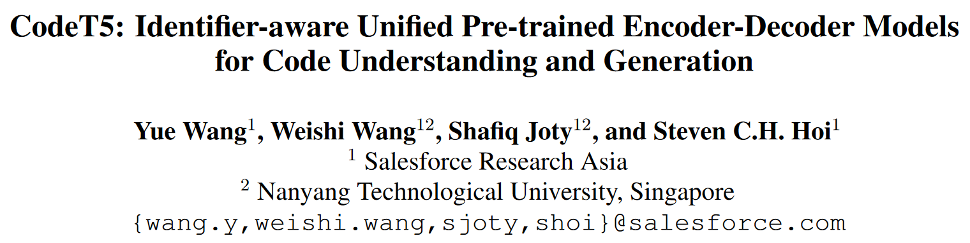

Slide 2
Motivation
Encoder-only model e.g. BERT is suboptimal for generation tasks.
The decoder used for generation cannot benefit from the pre-training.
Decoder-only model e.g. GPT is suboptimal for understanding tasks.
Most existing methods simply employ conventional NLP pretraining techniques that regard source code simply as token sequence.

Slide 3
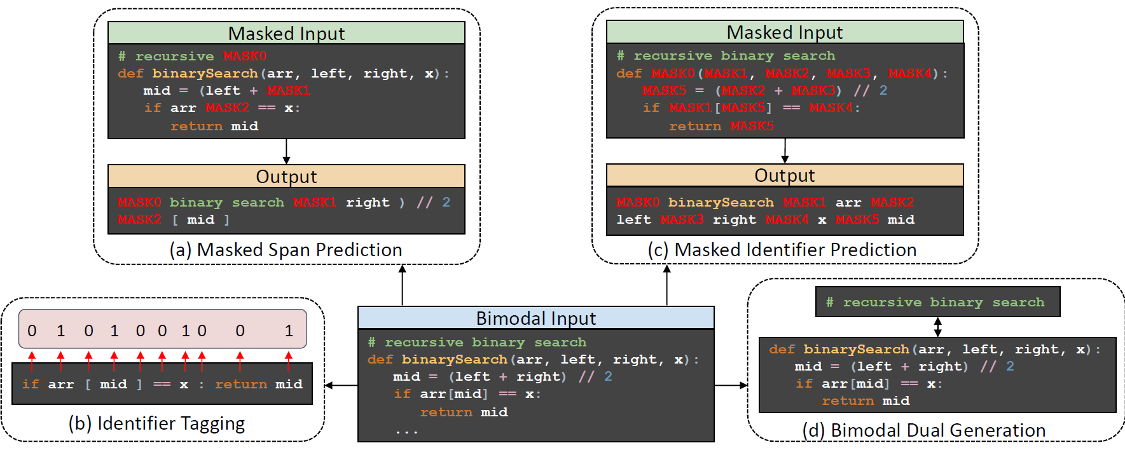

CodeT5
Inputs:
([CLS],$w_{1}$, ...,$w_{n}$, [SEP], $c_{1}$, ...,$c_{m}$, [SEP])
Masked Span Prediction (same as T5):

Slide 4
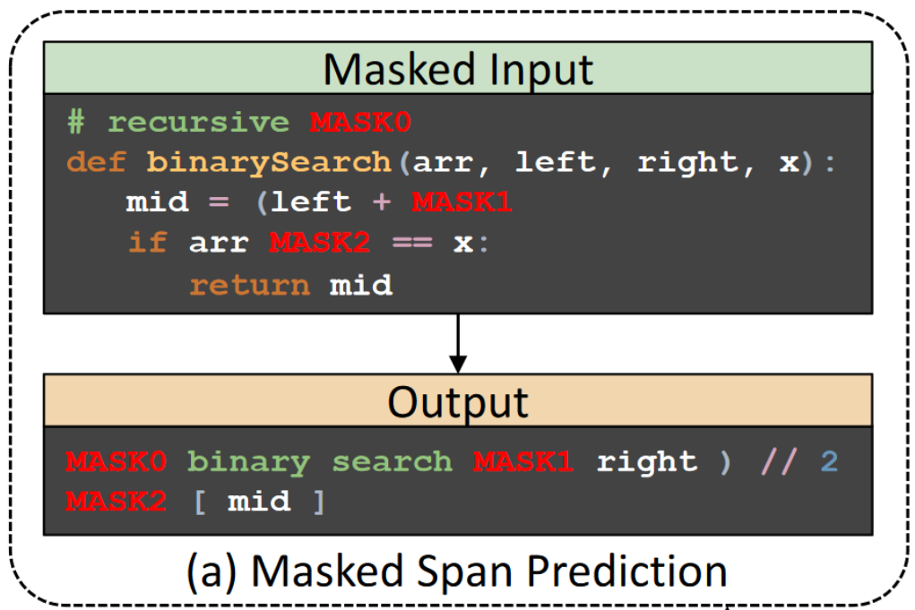
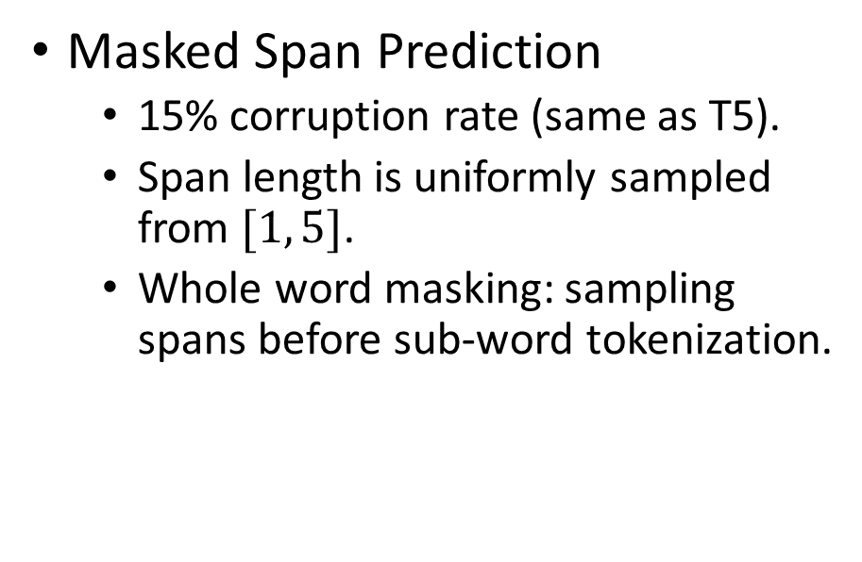
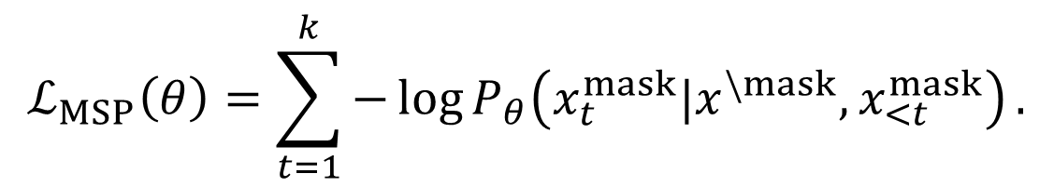
Notable points in pretraining
Masked Span Prediction
15% corruption rate (same as T5).
Span length is uniformly sampled from $[1, 5]$.
Whole word masking: sampling spans before sub-word tokenization.
$$ℒ_{MSP}\left(θ\right)=\sum_{t=1}^{k}{−\log{P_{θ}\left(x_{t}^{mask}|x^{\backslash mask},x_{<t}^{mask}\right)}}.$$

Slide 5
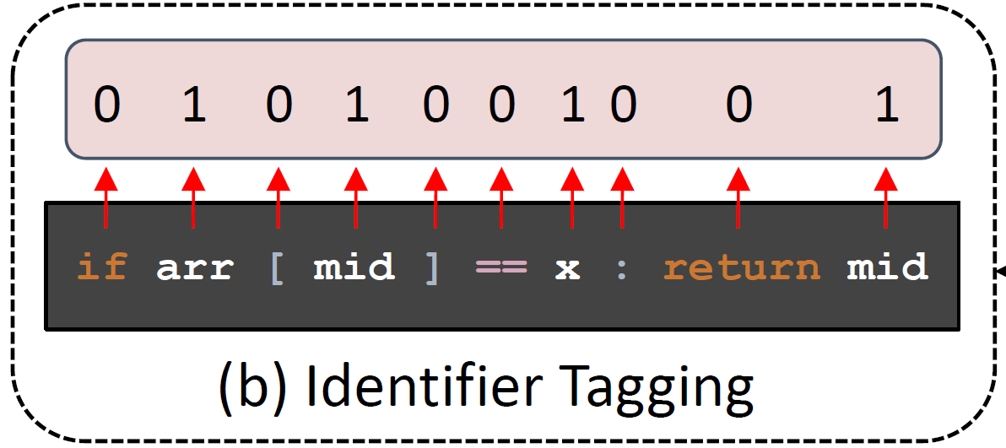
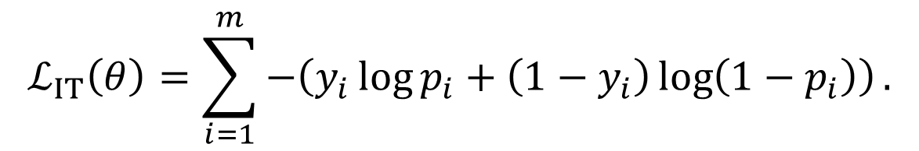
Notable points in pretraining
Identifier Tagging
The model is expected to capture the code syntax and the data flow structures of the code (really?).
$$ℒ_{IT}\left(θ\right)=\sum_{i=1}^{m}{−\left(y_{i}\log{p_{i}}+\left(1−y_{i}\right)\log\left(1−p_{i}\right)\right)}.$$

Slide 6
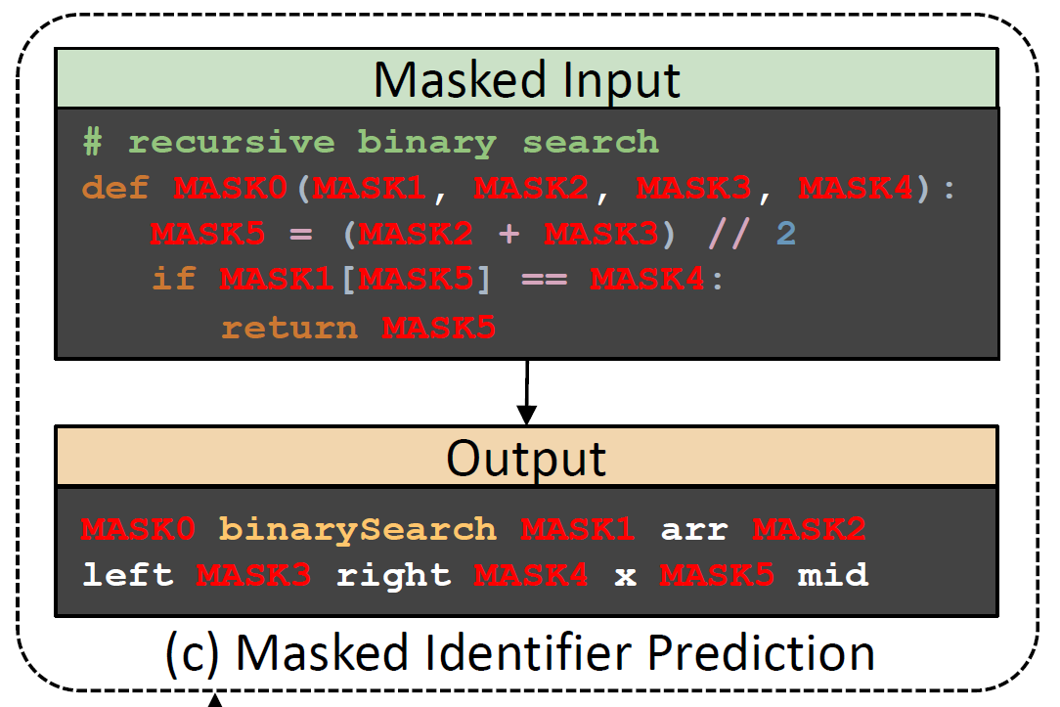
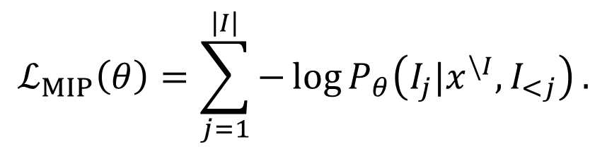
Notable points in pretraining
Masked Identifier Prediction
De-obfuscation.
Replace each identifier with a unique token.
Model needs to comprehend the code and link the occurrences of the same identifiers together.
$$ℒ_{MIP}\left(θ\right)=\sum_{j=1}^{\left|I\right|}{−\log{P_{θ}\left(I_{j}|x^{\backslash I}, I_{<j}\right)}}.$$

Slide 7
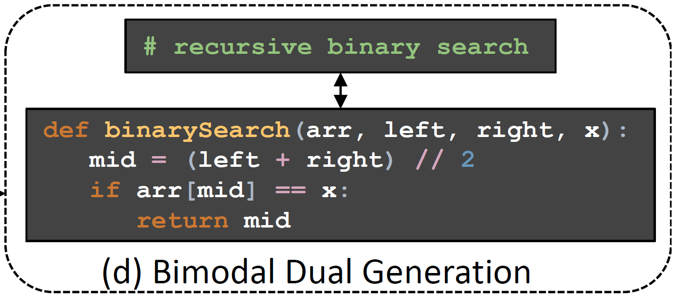
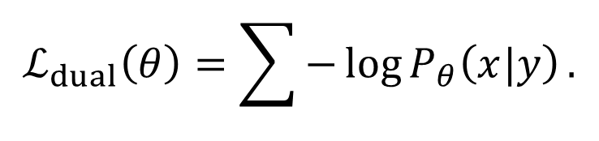
Notable points in pretraining
Bimodal Dual Generation
To close the gap between the pre-training and fine-tuning.
Aims to improve the alignment between the pair.
$$ℒ_{dual}\left(θ\right)=\sum{−\log{P_{θ}\left(x|y\right)}}.$$

Slide 8
Task-specific transfer learning for fine-tuning
Generation tasks: CodeT5 can be naturally adapted.
Understanding tasks:
Generate the label as a unigram target sequence.
Or predict the label from class labels based on the last decoder hidden state.

Slide 9
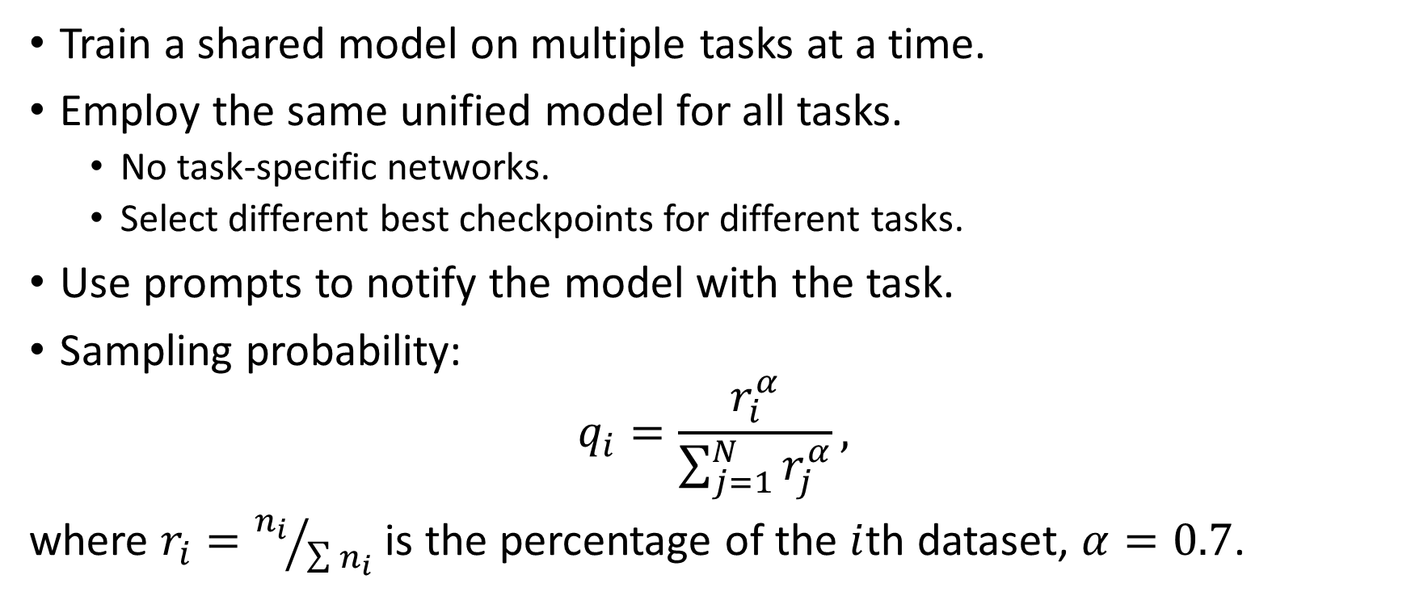
Multi-task learning for fine-tuning
Train a shared model on multiple tasks at a time.
Employ the same unified model for all tasks.
No task-specific networks.
Select different best checkpoints for different tasks.
Use prompts to notify the model with the task.
Sampling probability:
$$q_{i}=\frac{r_{i}^{α}}{\sum_{j=1}^{N}{r_{j}^{α}}},$$
where $r_{i}={n_{i}}/{\sum{n_{i}}}$ is the percentage of the $i$th dataset, $α=0.7$.

Slide 10
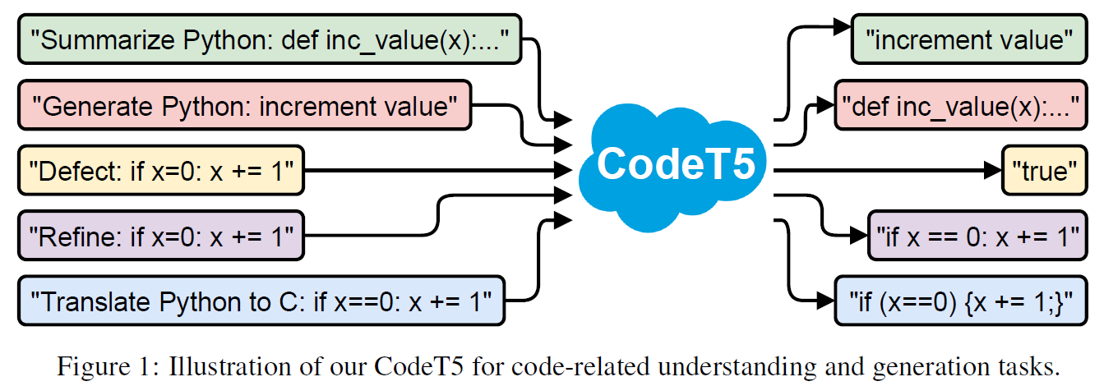
Multi-task learning prompts

Slide 11
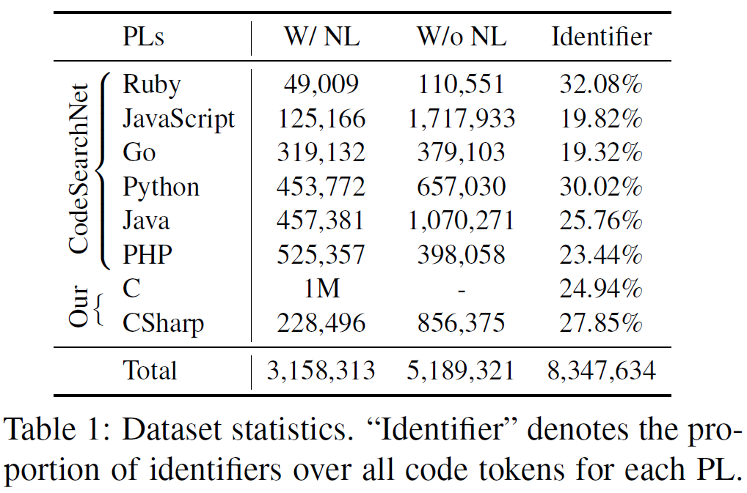
Pre-training Dataset
Bimodal data and unimodal data from CodeSearchNet.
Self-collected C data and C# data from Google BigQuery.
Use tree-sitter to convert the code into ASTs and find identifiers.

Slide 12
Downstream tasks
Most generation and understanding tasks in CodeXGLUE benchmark.
Code summarization: CodeSearchNet.
Code generation: CONCODE.
Code translation: Java ↔ C#.
Code repair: Bugs2Fix.
Defect detection: Devign.
Clone detection: BigCloneBench.

Slide 13
Baselines
Encoder-only:
RoBERTa.
RoBERTa (code).
CodeBERT.
GraphCodeBERT.
DOBF.
Decoder-only:
GPT-2.
CodeGPT-2.
CodeGPT-adapted (trained from a GPT-2 checkpoint).
Encoder-decoder:
PLBART.
DOBF is pretrained on 7.9M Java and 3.6M Python files from BigQuery.
PLBART is pretrained on 470M Python and 210M Java functions, and 47M NL posts from StackOverflow.
All other models are pretrained on CodeSearchNet.

Slide 14
Model Configurations
CodeT5-small: 60M; CodeT5-base: 220M.
Max source length: 512; max target length: 256.
Batch size: 1024; learning rate: 2e-4 with linear decay.
Pre-train the model with denoising objectives for 100 epochs.
Alternately optimize 3 pretraining losses with an equal probability.
Then bimodal dual training for 50 epochs.
On a cluster of 16 NVIDIA A100 GPUs with 40G memory.
5 days for CodeT5-small and 12 days for CodeT5-base.
Grid search for hyper parameters during fine-tuning.

Slide 15
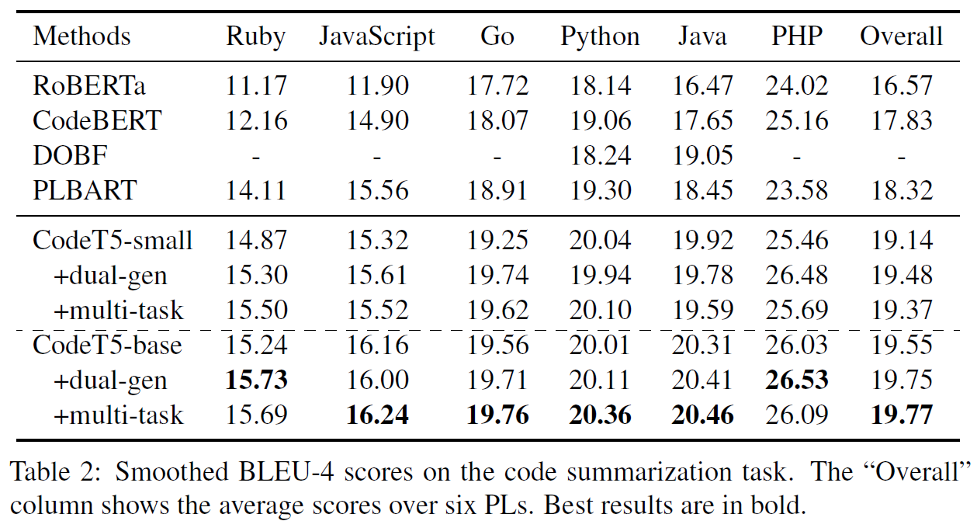
Code summarization results
Notes:
Significantly outperforms either encoder-only or encoder-decoder (PLBART) framework.
Gap between 2 groups confirms that encoder-only frameworks are suboptimal for generation tasks.
Why even CodeT5-small is better than PLBART despite smaller model (60M vs 140M) and much less data (<1%)? Identifier-aware pretraining and better employment of bimodal training data. (PLBART deals with 2 types of data separately.)
Dual-gen benefits tasks involving both NL and code, but hurts code-code tasks.
Multi-task boosts summarization since summarization takes up the largest portion of the subtasks.

Slide 16
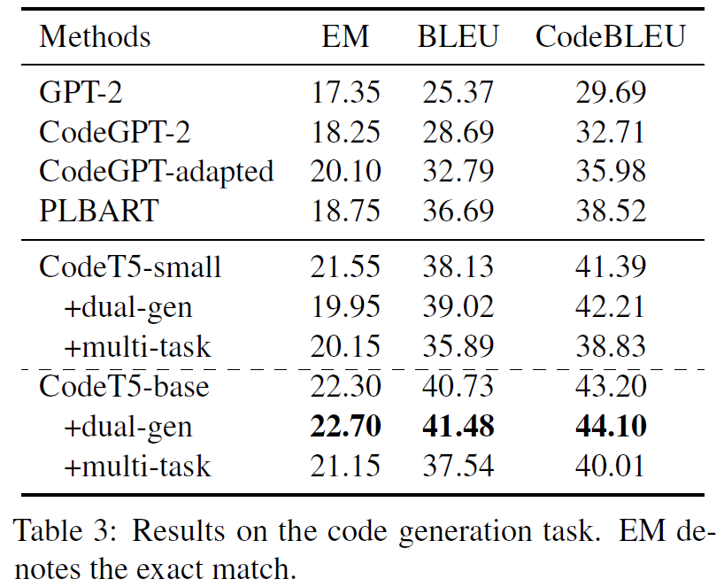
Code generation results
Notes:
Outperforms all decoder-only models and encoder-decoder PLBART.

Slide 17
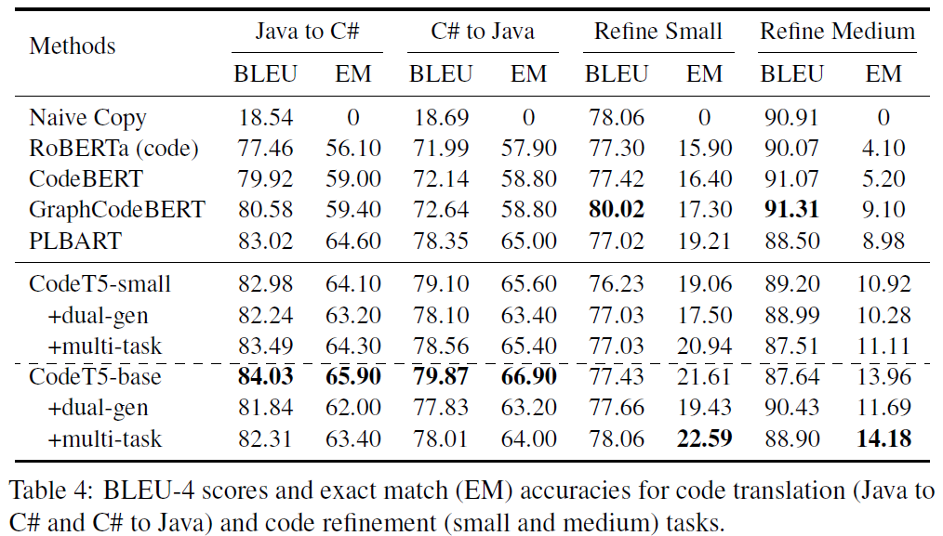
Code translation & repair results
Notes:
Code translation:
CodeT5-small is comparable with PLBART => encoder-decoder is better for code2code tasks.
CodeT5-base is really great.
Code repair:
Only EM is valuable.
Great on medium task.
Multi-task boosts code repair. Maybe due to joint training of small and medium data? Or maybe because the model can learn better code semantics.

Slide 18
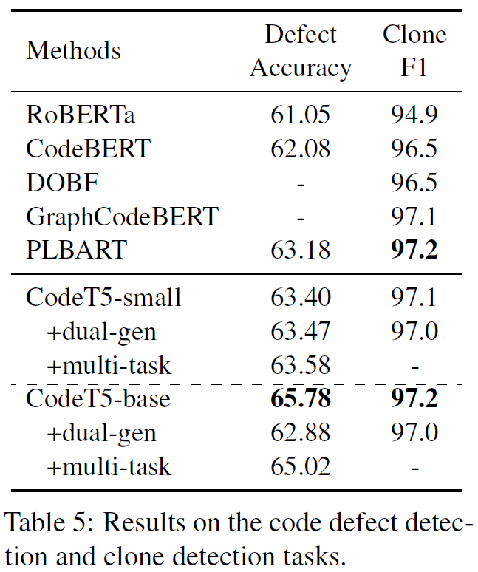
Code understanding results
Defect detection: generate the binary label as a unigram sequence.
Clone detection: predict the labels by measuring similarity between each code snippet's sequence embedding from last decoder state.
Notes:
Defect detection: best
Clone detection: comparable with GraphCodeBERT and PLBART.
CodeT5 can be adapted well even for understanding tasks.

Slide 19
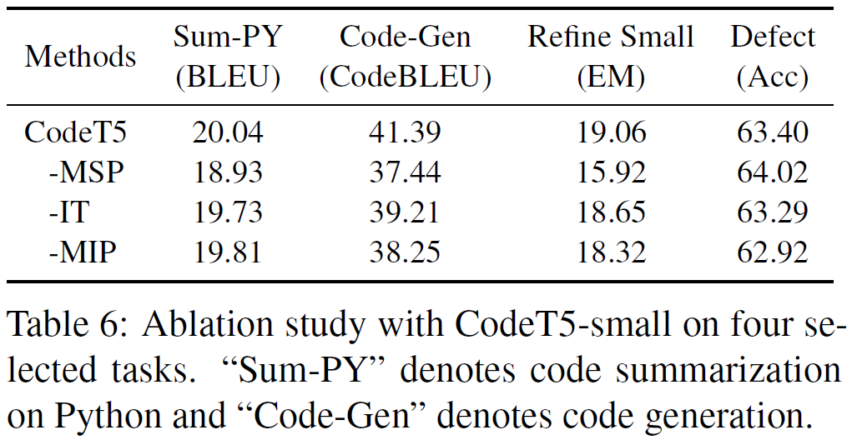
Ablation study on identifier-aware objectives
Notes:
Removing MSP would largely reduce performance of generation tasks but increase defect detection performance.
However, removing MIP hurts defect detection.

Slide 20
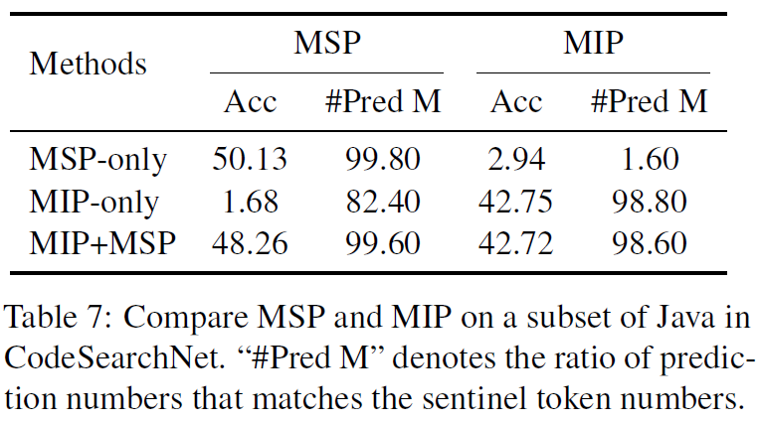
Semantic conflicts of MSP and MIP?
Notes:
Conflict since MSP and MIP use same masks?
Basically no conflict.

Slide 21
Conclusion
CodeT5, a pre-trained encoder-decoder model.
Readily available on https://huggingface.co.
Fine-tuning can be done on our servers.
Identifier-aware pretraining objectives is maybe helpful for sketch-based generation because filling sketch is basically generating identifiers.

